Slide 1
ASP.NET MVC Fundamentals
Controllers

Slide 2
Overview
MVC Controllers
Controller Factories
Actions
Action Filters
Action Results

Slide 3
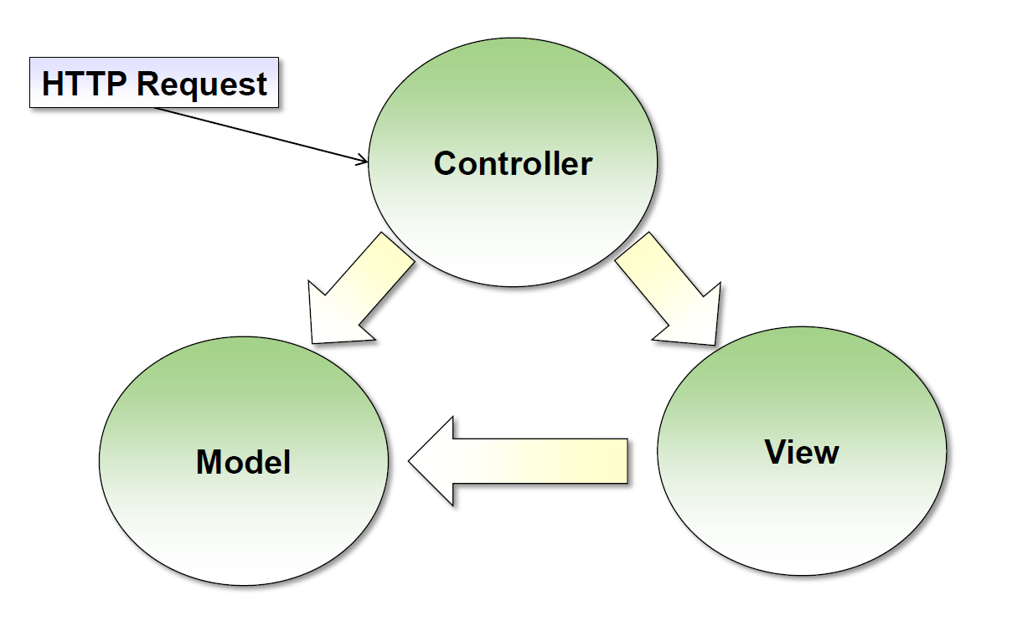
Controllers are keys

Slide 4
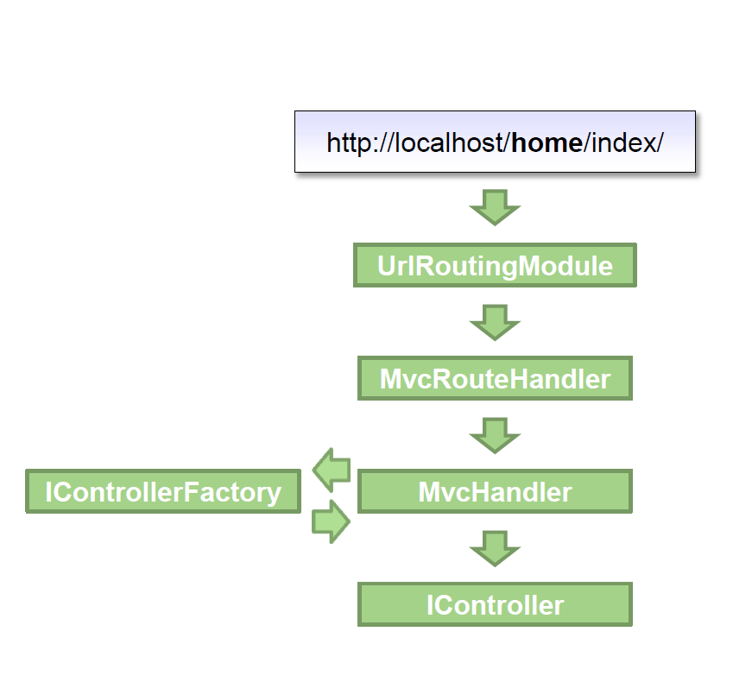
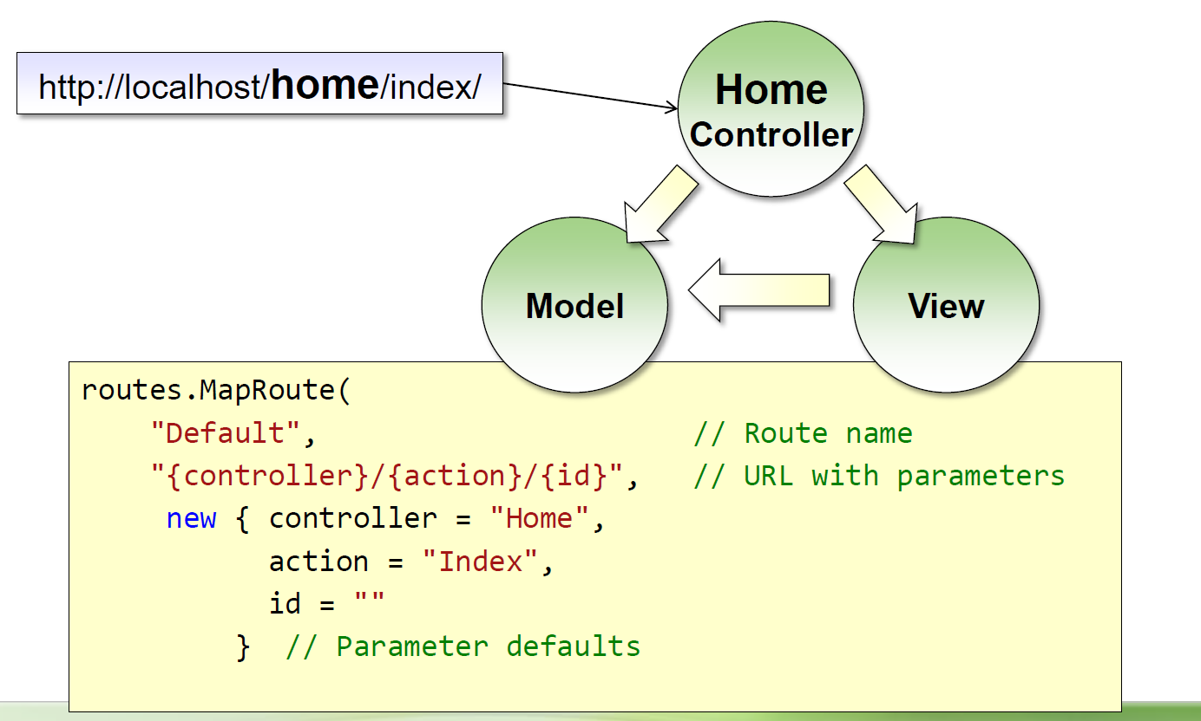
Routes & Controllers
Lifetime of controller depends on Routing
Routing Engine doesn’t know anything about Asp.Net MVC
Routing Engine’s Job is to check Routing Table and match the incoming URL to direct to proper component
MapRoute method is an Extension Method that maps MVC Route Handler into the Routing Engine

Slide 5
MVC Request Processing
UrlRoutingModule
  Routing engine is agnostic
  Logic for the Route engine is inside the UrlRoutingModule class
  UrlRoutingModule class is an HttpHandler configured into ASP.NET Pipeline for MVC Applications
MvcRouteHandler
  MapRoute Extn. method configures RouteHandler called MvcRouteHandler
  Responsible for handling MVC request
MvcHandler (IHttpHandler)
  Checks the RouteData from request like controller, action etc.
  Communicate with ControllerFactory with RouteData to Instantiate controller
  Disposes controller
IControllerFactory
  Responsible to Instantiate the controller that implements IController interface
IController
  Lowest level abstraction

Slide 6
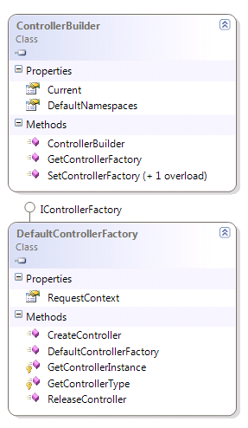
DefaultControllerFactory
Finds controllers
  Looks in all referenced assemblies
  Looks in all namespaces
  Type name ends with “Controller”
  Type implements IController
Instantiates controllers
  Controller must have a default constructor

Slide 7
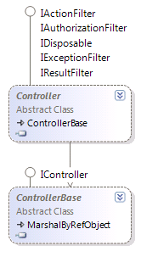
Controller Execution
IController
  Execute method invoked by MvcHandler
  Writes to the response stream
ControllerBase
  Introduce a richer execution environment
  Introduces ViewData & ControllerContext
Controller (Abstract base class)
  Default base class in MVC
  Introduces Actions
  Includes helper methods for rendering content

Slide 8
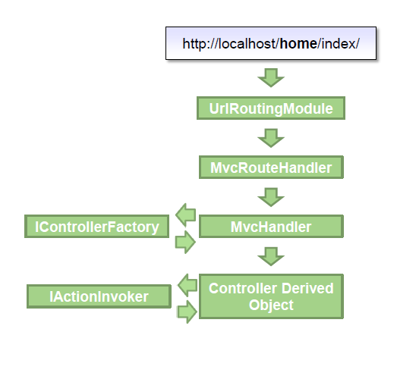
Actions
Actions are the ultimate request destination
  Execute method of IController interface creates an ActionInvoker
  ActionInvoker looks in RouteData to find Action parameter data and invokes the action
  All public methods inside controller are Action Methods
  Action Methods must be non-static methods
  Action Methods must return a value, there is no point of returning nothing from Action Method.

Slide 9
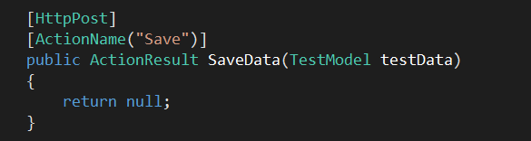
Action Selector Filters
Specified as attributes
ActionName
  Overrides default of action name == method name
  Method name is no longer a valid action
AcceptVerbsattribute
  Restricts invocation to specified verbs

Slide 10
Action Parameters
Action Invoker Maps Action Method Parameters with the data that is there in MVC Environment.
Actions can take a variety of parameters
Primitive parameters (int, bool, string)
  Map from route data
  Map from form data
  Map from query string
  If parameter is not found a null reference is passed
Action Invoker also works with Complex parameters
  Framework uses model binder to map properties
  Public properties of object mapped to data sources listed above
  You can define custom model binders

Slide 11
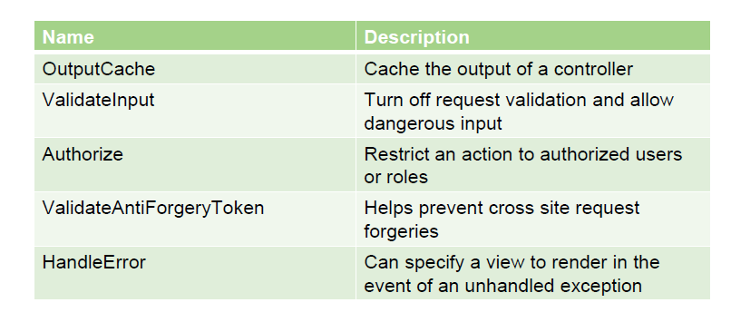
Filter Attributes
Similar to Selector Attribute that we can apply at an action level
Can also apply at controller level, which will apply at all actions on controller

Slide 12
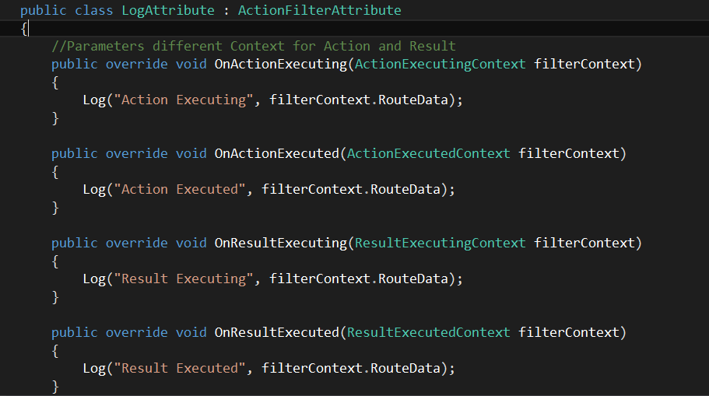
Custom Action Filters
Derive from ActionFilterAttributebase class

Slide 13
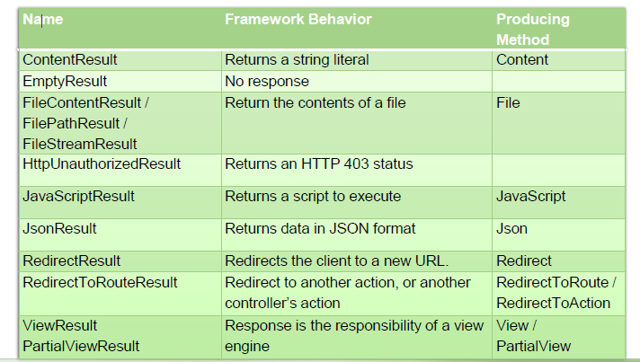
Action Results
Actions typically return an ActionResult
ActionResult is the base class for all return results

